Slide 1
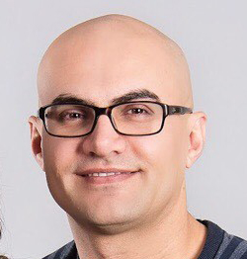
From A to PWA
the life ahead
of us
Yaser Adel Mehraban
@yashints

Slide 2

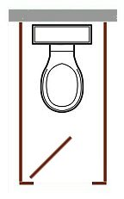

Slide 3
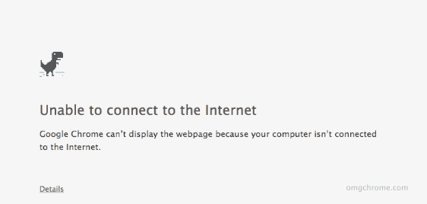
Offline

Slide 4
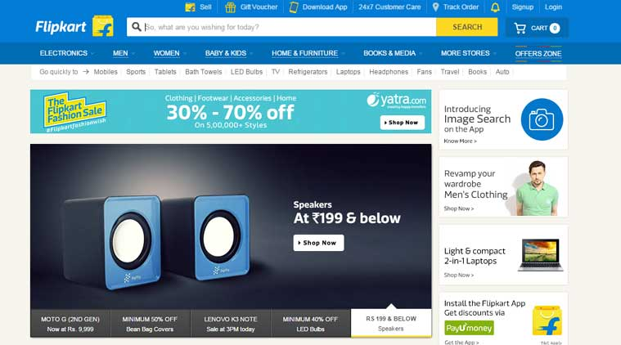
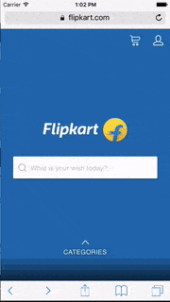

PWA

Slide 5
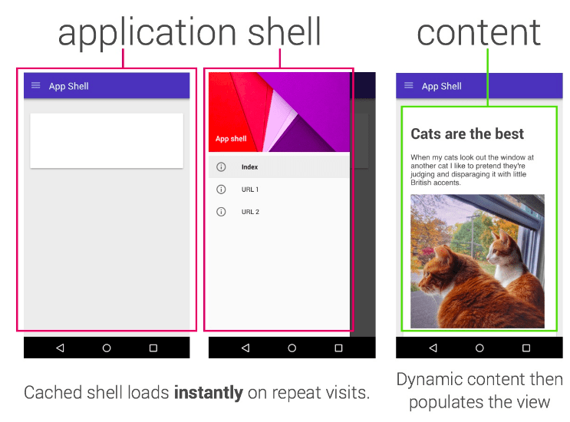
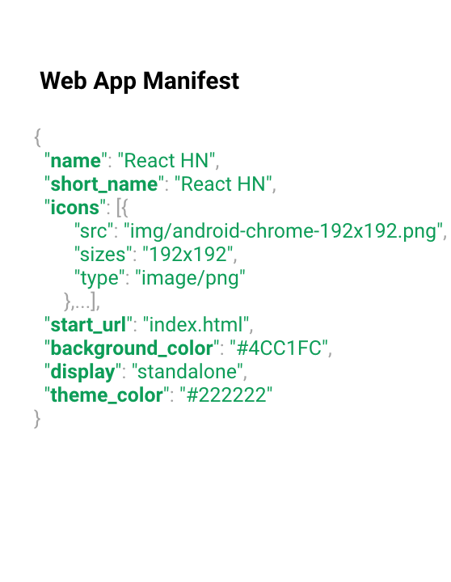

Key components
Service Worker

Slide 6
Service Worker

Slide 7
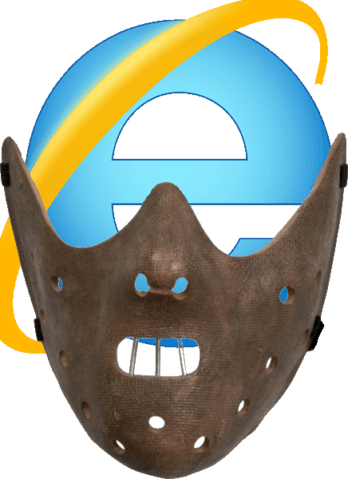
Start
From the page
if (navigator.serviceWorker) {
navigator.serviceWorker.register('/sw.js');
}
Sw.js
console.log('Hello from service worker!');

Slide 8
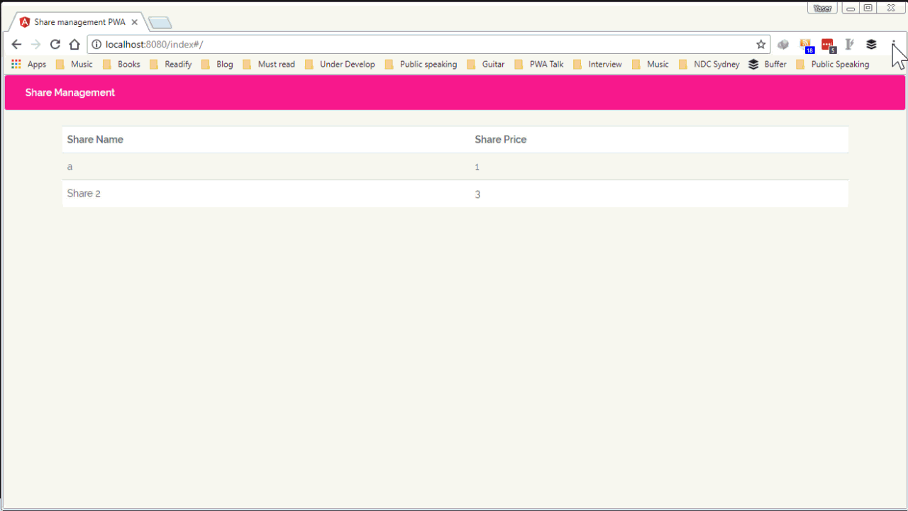
Show console from service worker

Slide 9
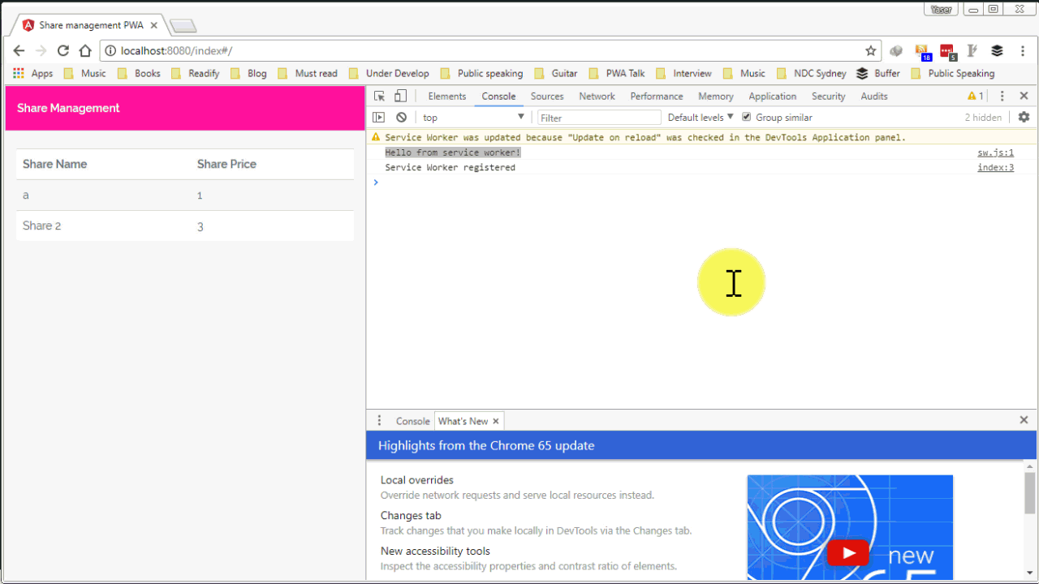
Show service worker installed

Slide 10
Fetch
self.addEventListener('fetch', function(event) {
event.respondWith(
new Response('Hello')
);
});

Slide 11
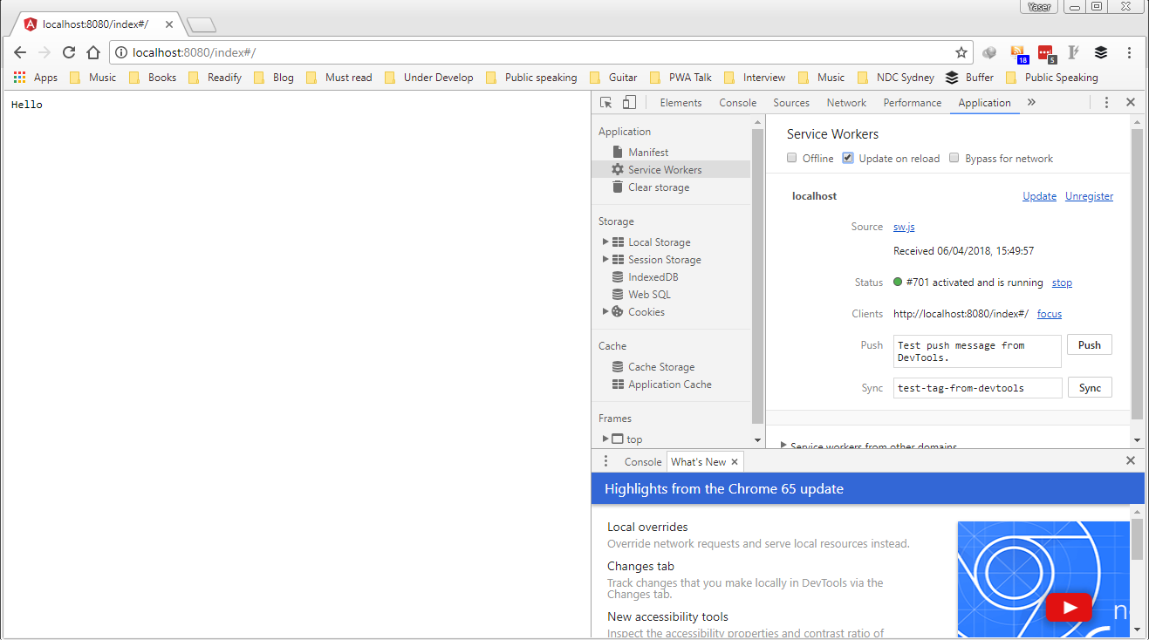
Show check update on reload

Slide 12



Page
Network

Slide 13

Page
Service worker
Network

Slide 14
Interception
self.addEventListener('fetch', function(event) {
const url = new URL(event.request.url);
if (url.pathname.endsWith('.png')) {
event.respondWith(
fetch('assets/images/cat.jpg')
);
}
});

Slide 15
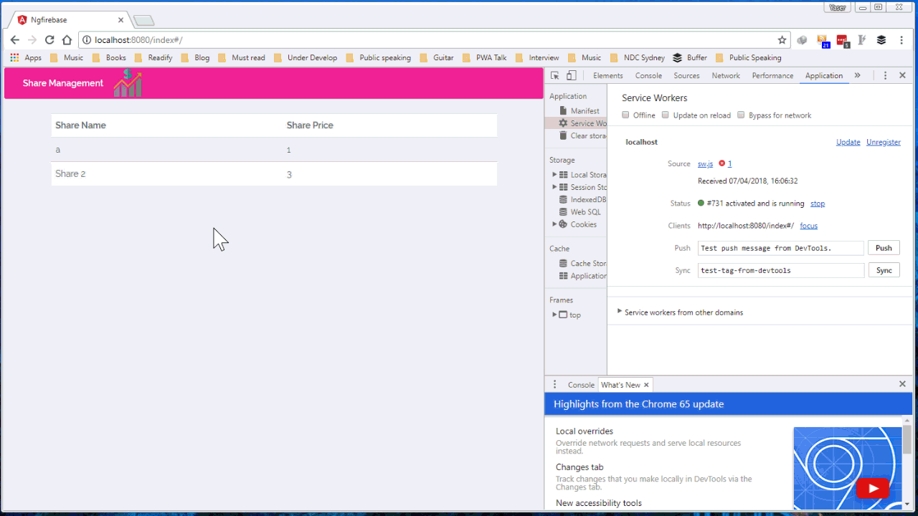

Slide 16
Changing the response
self.addEventListener('fetch', function(event) {
event.respondWith(
fetch(event.request).then(response => {
if(response.status === 404) {
return fetch('assets/images/404.jpg');
}
return response;
})
);
});

Slide 17
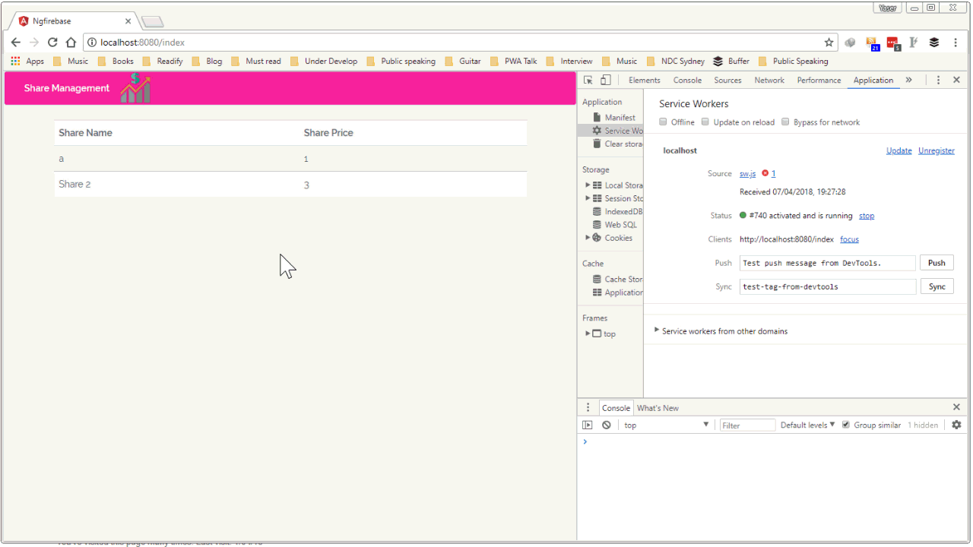

Slide 18
Handling offline
self.addEventListener('install', function(event) {
event.waitUntil(
caches.open('static-v1')
.then(cache => cache.addAll([
'/offline-d7ahhsa.html',
'/offline-styles-67fj65k.css',
'/assets/images/offline.png'
]))
);
});

Slide 19
Handling offline
self.addEventListener('fetch', function(event) {
event.respondWith(
caches.match(event.request)
.then(response => response || fetch(event.request))
.catch(() => {
if (event.request.mode == 'navigate') {
return caches.match('offline-d7ahhsa.html')
}
})
);
});

Slide 20
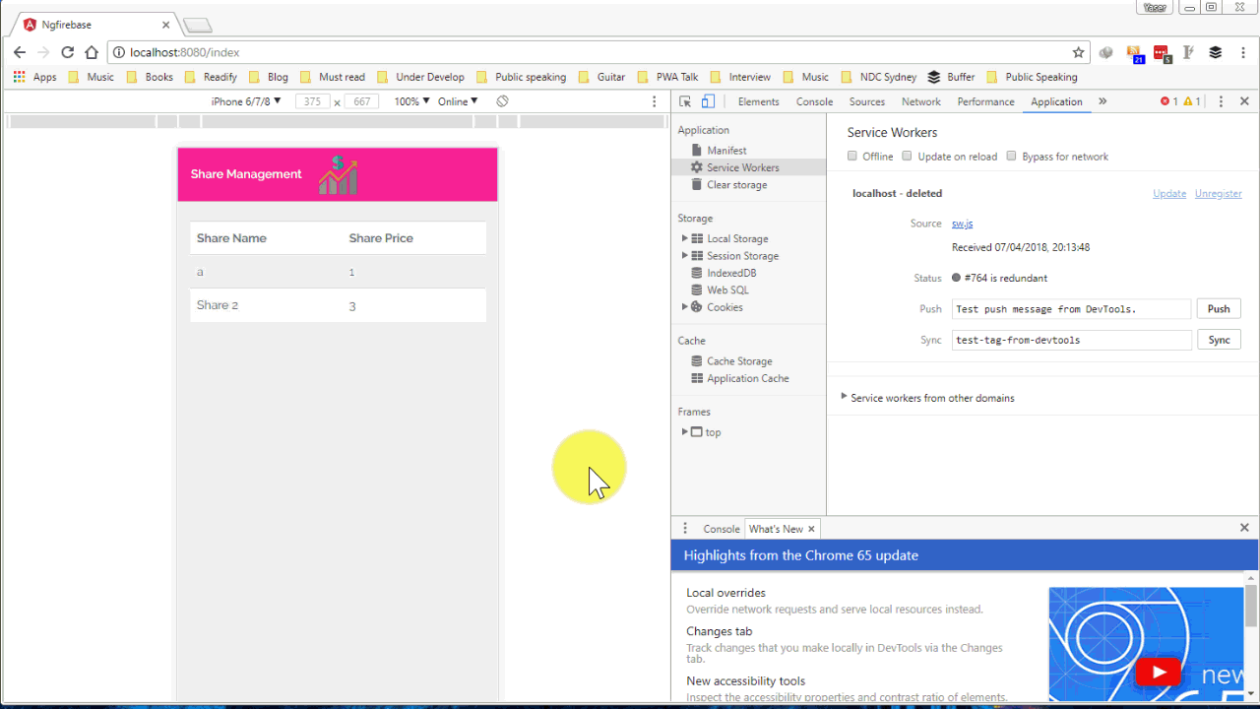

Slide 21
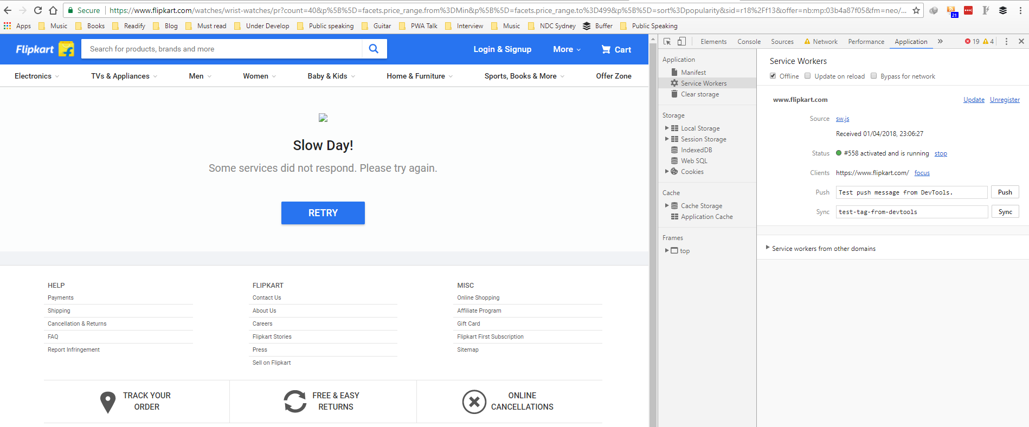

Slide 22
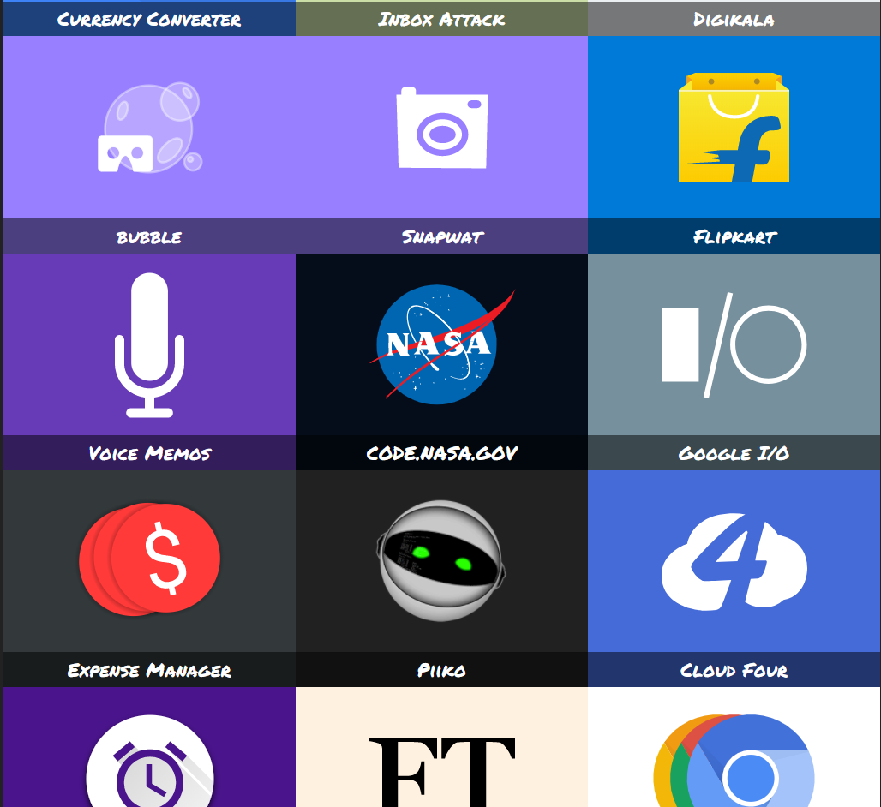
https://pwa.rocks/

Slide 23
Web App Manifest
<!doctype html>
<html lang="en"> <head> <meta name="viewport" content="width=device-width, initial-scale=1">
<meta name="theme-color" content="#ff1493">
<meta name='HandheldFriendly' content='True'>
<meta name='MobileOptimized' content='320’>
<meta name='date' content='Sep. 27, 2010’>
<link href='/apple-touch-icon.png' rel='apple-touch-icon' type='image/png'>
<link href='touch-icon-ipad.png' rel='apple-touch-icon' sizes='72x72'>
<link href='touch-icon-iphone4.png' rel='apple-touch-icon' sizes='114x114'>
<link href='/startup.png' rel='apple-touch-startup-image'>
<link rel='apple-touch-icon' href='touch-icon-iphone.png'>
<link rel='apple-touch-icon' sizes='76x76' href='touch-icon-ipad.png'>
<link rel='apple-touch-icon' sizes='120x120' href='touch-icon-iphone-retina.png'>
<link rel='apple-touch-icon' sizes='152x152' href='touch-icon-ipad-retina.png'>

Slide 24
Web App Manifest
<!doctype html>
<html lang="en">
<head>
<meta name="viewport" content="width=device-width, initial-scale=1">
<meta rel="manifest" href="/manifest.json">

Slide 25
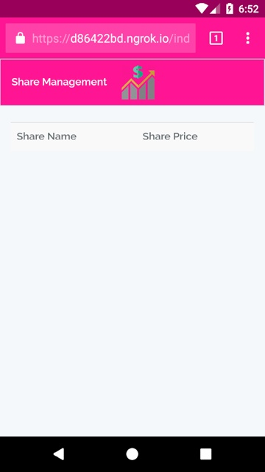
{
"name": "Share Management",
"short_name": "ShareInfo",
"theme_color": "#ff1493",
"background_color": "#EEE",
"display": "standalone",
“scope": "/",
"start_url": "/",
"icons": [
]
}
Web App Manifest

Slide 26
Offline

Slide 27


Slide 29
navigator.online == false
You have no connection
navigator.online == true
You have not no connection
Network status API’s

Slide 30
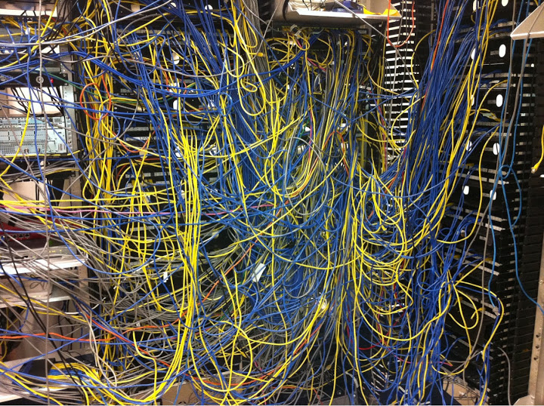

Slide 31
Offline first
Using an application shell

Slide 32
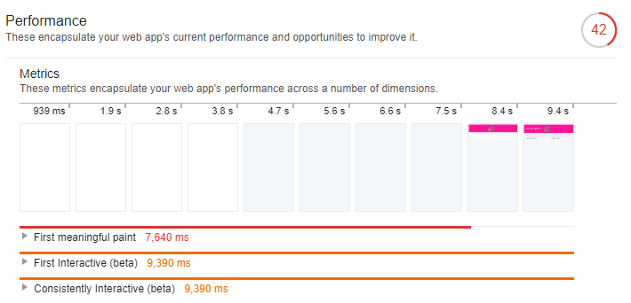

Slide 33
Cache the shell
self.addEventListener('install', function(event) {
event.waitUntil(
caches.open('static-v3')
.then(cache => cache.addAll([
'/shell-b95484h.html',
'/styles-ure783.css',
'/script-jh348f.js'
]))
);
});

Slide 34
Return cached items
self.addEventListener('fetch', function(event) {
const url = new URL(event.request.url);
if (url.origin == location.origin && url.pathname == '/') {
event.respondWith( caches.match('shell-b95484h.html'));
return;
}
event.respondWith(
caches.match(event.request)
.then(response => response || fetch(event.request))
);
});

Slide 35
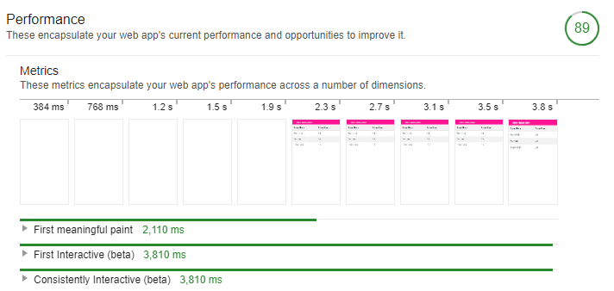

Slide 36
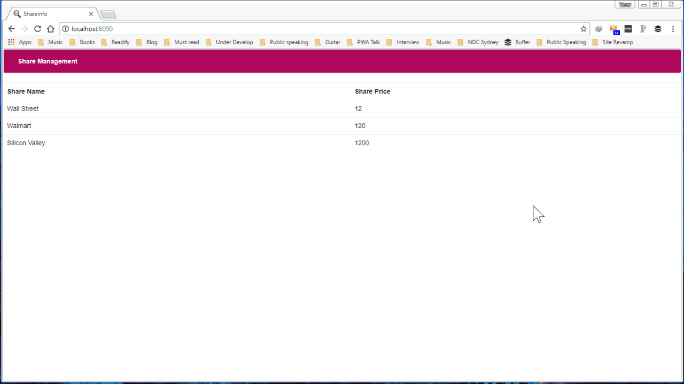

Slide 37
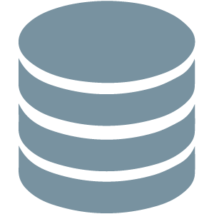
Caching other resources
IndexedDB

Slide 38
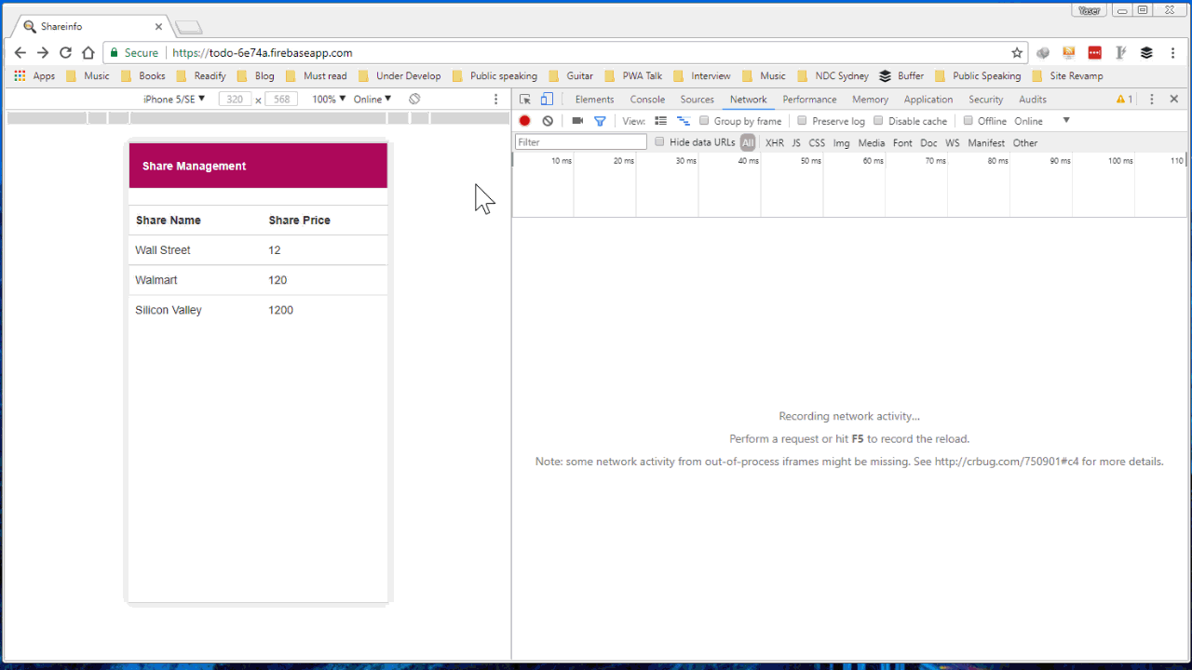

Slide 39
PRPL pattern
<link rel="dns-prefetch" href="//example.com">
<link rel="preconnect" href="http://css-tricks.com">
<link rel="prefetch" href="image.png">
<link rel="subresource" href="styles.css">
<link rel="prerender" href="http://css-tricks.com">
Notes:
Much like the DNS prefetch method, preconnect will resolve the DNS but it will also make the TCP handshake, and optional TLS negotiation.
Another prefetching technique helps identify the resources that are the highest priority and should be requested before prefetched items.
This is like opening the URL in a hidden tab – all the resources are downloaded, the DOM is created, the page is laid out, the CSS is applied, the JavaScript is executed, etc.

Slide 40
Summary

Slide 41
Thank you
Yaser Adel Mehraban
@yashints

